Slide 1

E6156 – Cloud Computing:
Backend-as-a-Service
Lecture 10: Overall Site Company Image, API GW, API Gateway Authorizer, Step Functions, Message Drive Apps.
Donald F. Ferguson dff9@Columbia.edu
TRANSCENDING DISCIPLINES, TRANSFORMING LIVES

Slide 2

We will start in a couple of minutes.
2 | E6156 – Cloud Computing: Backend-as-a-Service: Lecture 8

Slide 3
Single Site Image Certificate, DNS, CloudFront, API Gateway
3 | E6156 – Cloud Computing: Backend-as-a-Service

Slide 4
Domain Names and URLs
You have seen that deploying microservices and endpoints can result in some strange URLs. For example, some of mine are:
API GW: https://y9id42n6b0.execute-api.us-east-1.amazonaws.com/
Static content: https://e6156f20site.s3.us-east-2.amazonaws.com/WebSite/
EC2 Flask endpoint: ec2-3-86-201-238.compute-1.amazonaws.com
http://e6156products-env.eba-q3nrc2nh.us-east-1.elasticbeanstalk.com/ (Note: This is not HTTPs, and insecure).
These DNS names are “weird” and do not look like they come from a common company or organization.
Your probably want something like:
https://www.dff-e6156.org/index.html
https://api.dff-e6156.org/users
https://api.dff-e6156.org/accounts
... ...
Accomplishing this requires:
A domain.
Certificates for the domain.
DNS entries.
Routing front end that routes to actual endpoints based on URL and path.

Slide 5
Domain Names and URLs
You have seen that deploying microservices and endpoints can result in some strange URLs. For example, some of mine are:
API GW: https://y9id42n6b0.execute-api.us-east-1.amazonaws.com/
Static content: https://e6156f20site.s3.us-east-2.amazonaws.com/WebSite/
EC2 Flask endpoint: ec2-3-86-201-238.compute-1.amazonaws.com
http://e6156products-env.eba-q3nrc2nh.us-east-1.elasticbeanstalk.com/ (Note: This is not HTTPs, and insecure).
These DNS names are “weird” and do not look like they come from a common company or organization.
Your probably want something like:
https://www.dff-e6156.org/index.html
https://api.dff-e6156.org/users
https://api.dff-e6156.org/accounts
... ...
Setting all of this up can be tedious and error prone.
Not as tricky as ECS, but still unpleasant.
Also, this is cloud
Infrastructure design and management.
Not cloud application development.
These are different roles and teams in most cases.
Basic familiarity with the concepts is helpful.
We will not have milestones/tasks on these topics.
Accomplishing this requires:
A domain.
Certificates for the domain.
DNS entries.
Routing front end that routes to actual endpoints based on URL and path.

Slide 6
Single Site Image Certificate, DNS, CloudFront, API Gateway
6 | E6156 – Cloud Computing: Backend-as-a-Service

Slide 7
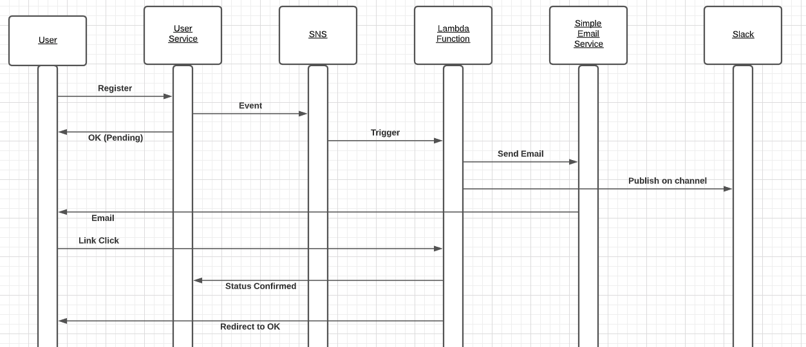
Reminder: Scenario – Email ID Verification
Requires defining a Slack Webhook
Users provide email IDs when registering with the overall application.
Account is pending until email ownership verified.
User receives and email with activation link. Clicking on link changes account state to active.
Some, e.g. interested business person, sees notification on a Slack channel.
7 | E6156: Topics in SW Engineering – Cloud Computing/BaaS

Slide 8
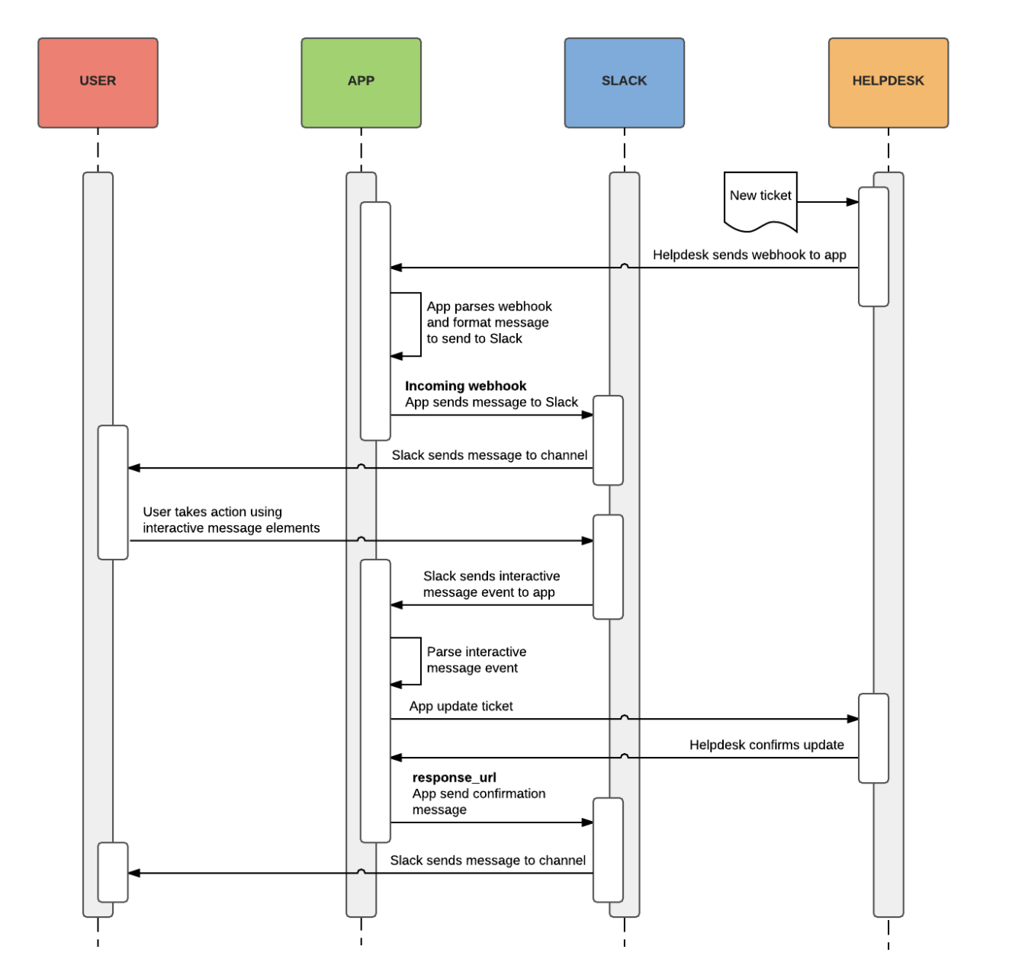
Webhooks
General concept:
“A webhook in web development is a method of augmenting or altering the behavior of a web page or web application with custom callbacks. These callbacks may be maintained, modified, and managed by third-party users and developers who may not necessarily be affiliated with the originating website or application.” (https://en.wikipedia.org/wiki/Webhook)
Webhooks allow user notification or triggering operations at site T when something interesting happens on site S. The semantics of what “is interesting” depends on sites and applications.
Slack provides some examples, including a help desk scenario. (https://api.slack.com/best-practices/blueprints/actionable-notifications)
Many sites APIs support Webhooks.
8 | E6156: Topics in SW Engineering – Cloud Computing/BaaS

Slide 9
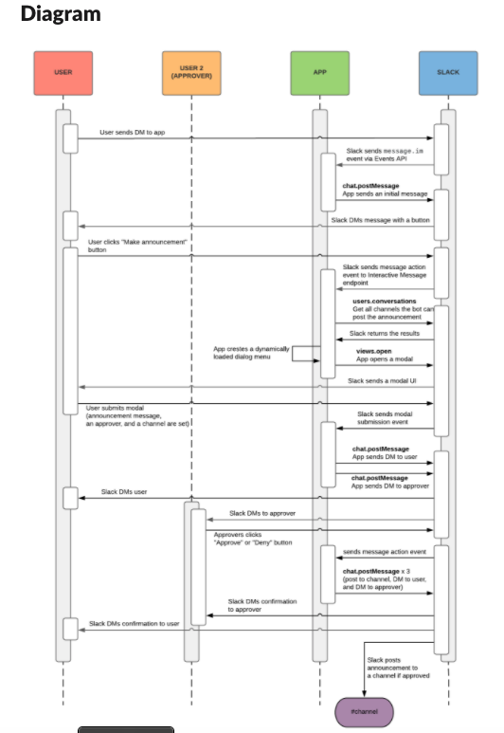
Webhooks
1. Receive a direct message
To find out when a user sends a direct messages to the app's bot we need to subscribe to the im.message bot event sent out through the Events API. The Events API sends a POST request to a specified URL whenever certain events occur in a Slack workspace. In the case of the im.message bot event, Slack will send an event as soon as the app's bot receives a direct message. The event will include information about both the message and the user who sent it.
2. Open a modal
Once a user sends the bot a direct message, the bot replies with a button to start a new announcement. When a user clicks this button, the bot will receive a request on its Interactive Components endpoint. Using the trigger_id in that payload, the bot can make a call to the views.open endpoint to open up a modal with the user. The user can draft their announcement in this modal and submit it to the bot. To include interactive functionality such as buttons and modals, you'll need to enable Interactive Components in the app settings and supply a URL.
3. Preview the message
When the bot receives the modal submission, the bot will respond to the direct message with a preview of what that announcement would like using the chat.postMessagemethod. The app will also append a 'send request' message button to the message. The user can click this button to send a request to an admin for approval.
4. Send the message to an approver
When the user clicks the 'send request' button, the app will receive a POST request on its Interactive Message endpoint. The request will include details about who clicked the button, the contents of the original message, and a response URL. The response URL can be used by the app to update the content of the original message using an HTTP request with a JSON payload. When the message action request is received, the bot sends a direct message to a predefined approver asking them to either 'accept' or 'reject' the message using message buttons. At the same time, it sends an update to the user using the response URL to let them know that the message is pending approval.
5. Let the user make the final decision
Once the admin has approved the announcement, the app sends a message to the user using the chat.postMessage web API method. The message shows the updated status of the approval along with "post announcement" and "cancel" message buttons.
6. Post the message to the channel
When the user is ready to post the announcement, they can click the "post announcement" button, and the announcement will be posted to the announcements channel using chat.postMessage and the installers bearer token. The app can then replace its own "post announcement" message to the user with a confirmation that it's been posted, and optionally the link to the announcement itself.
9 | E6156: Topics in SW Engineering – Cloud Computing/BaaS

Slide 10
Some REST Concepts
10 | E6156 – Cloud Computing: Backend-as-a-Service

Slide 11
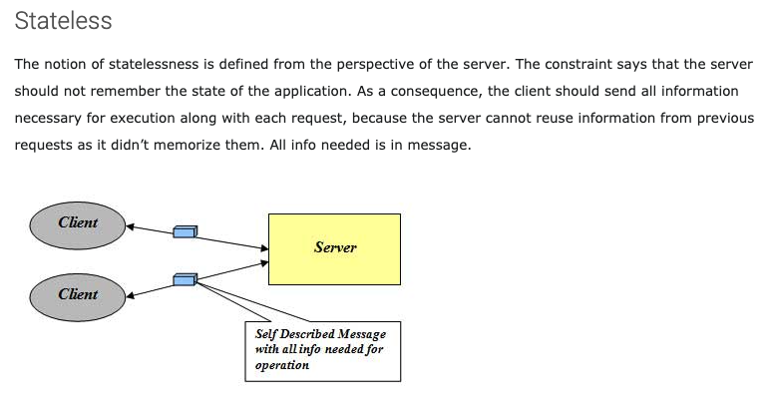
Stateless
http://mrbool.com/rest-architectural-elements-and-constraints/29339
JWT Token A
JWT Token B
JWT Token C

Slide 12
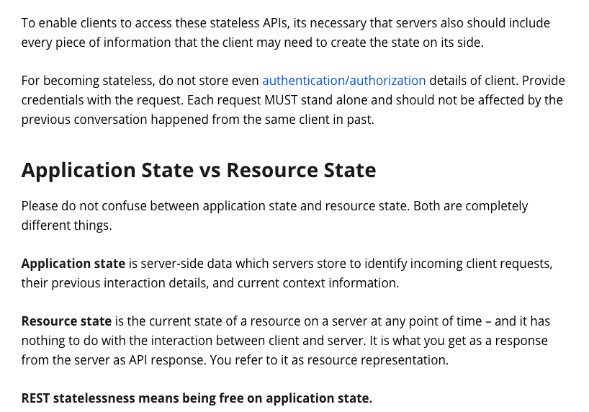
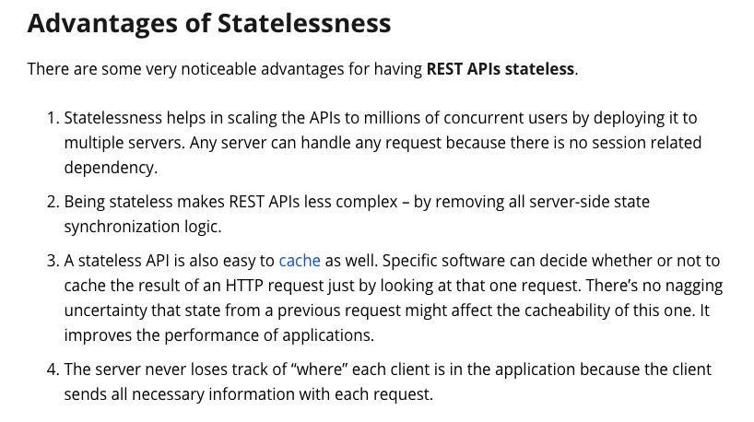
Stateless

Slide 13
REST and Isolation: Read then Update Conflict
Some
Resource
1. Bob GETs the resource.
3. Bob changes the data based on values.
2. Mary GETs the resource.
If
The written value
Depends on the read value.
The resource may be in the wrong state at the end.
The execution was RRWW
But the intent was RWRW.
4. Mary changes the data based on values.

Slide 14
Isolation/Concurrency Control
This requires conversation state, which would violate the REST Stateless principle.
There are two basic approaches to implementing isolation
Locking/Pessimistic, e.g. cursor isolation
Optimistic: Before committing, each transaction verifies that no other transaction has modified the data it has read.
How does this work in REST?
The server maintains an ETag (Entity Tag) for each resource.
Every time a resource’s state changes, the server computes a new ETag.
The server includes the ETag in the header when returning data to the client.
The server may optionally maintain and return “Last Modified” time for resources.
Semantics on updates
If-Match – value of a previous calls ETag response used with a PUT or DELETE. Server should only act if nobody else has modified the resource since you last fetched it. Otherwise provides a 412.
If-Modified-Since – value of a previous Last-Modified response used with a GET. Server should only provide a response if the resource was modified since the timestamp submitted. Use in conjunction with If-None-Match in case the change occurred within the same second. Otherwise provide a 304.
If-None-Match – value of a previous calls ETag response used with a GET. Server should only provide a response if the ETag doesn’t match, i.e. the resource has been altered. Otherwise provide a 304.
If-Unmodified-Since – value of a previous Last-Modified response used with a PUT or DELETE. Server should only act if nobody else has modified the resource since you last fetched it. Otherwise provides a 412

Slide 15
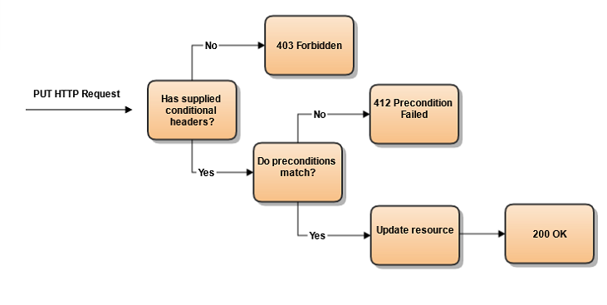
Conditional Processing (https://blog.4psa.com/rest-best-practices-managing-concurrent-updates/)

Slide 16
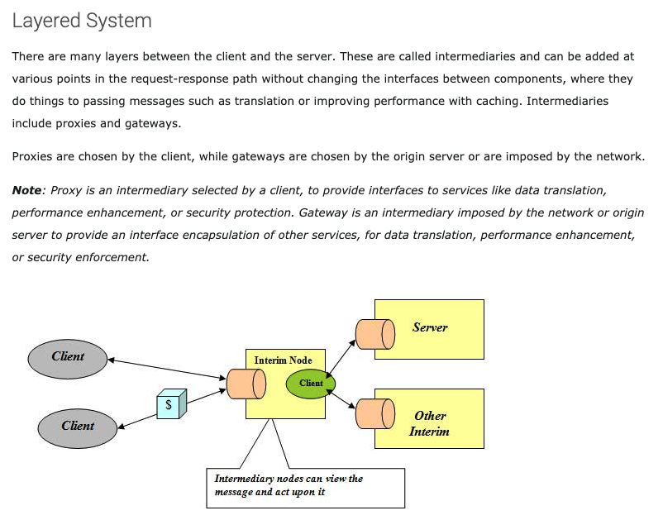
Layered System
Layered System
Proxy/Intermediary provides “middleware”
Separation of Concerns
Examples
Caching
Logging
Security
Queuing
... ...
Middleware
API Gateway
CloudFront
Proxy

Slide 17
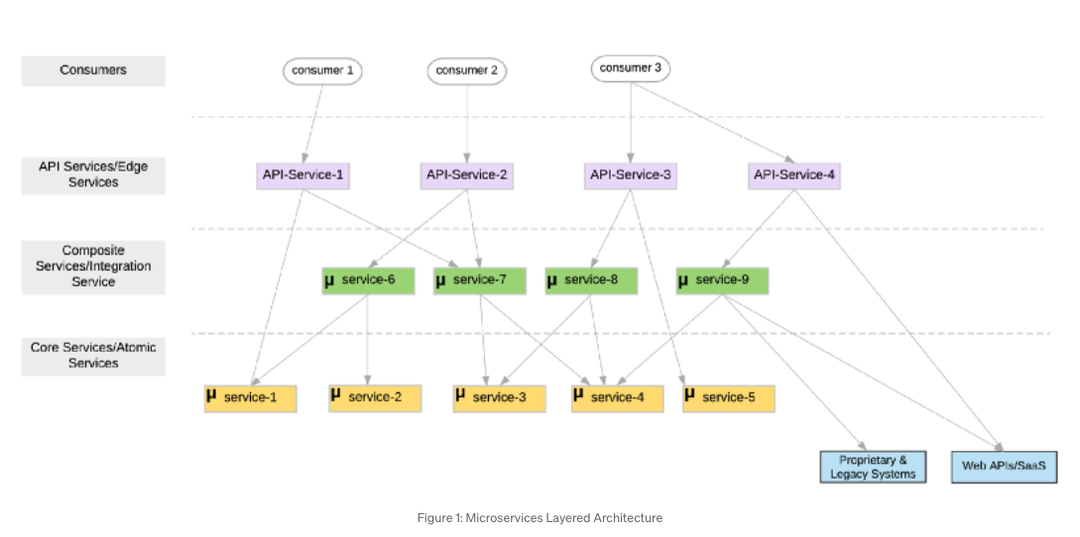
Layered Architecture
https://medium.com/microservices-in-practice/microservices-layered-architecture-88a7fc38d3f1

Slide 18
Layered Architecture
https://medium.com/microservices-in-practice/microservices-layered-architecture-88a7fc38d3f1
1. Core/Atomic Microservices
At the bottom layer, we have fine-grained self-contained services (no external service dependencies) that mostly comprise of the business logic and less or no network communication logic.
2. Composite/Integration Microservices
Atomic microservices are often cannot be directly mapped to a business functionality as they are too fine-grained. Hence a specific business functionality may require a composition of multiple atomic/core services. The middle layer comprises of such composite or integration microservices. ... ...
Composite/integration services are coarse-grained(relative to atomic services), independent from each other and contains business logic(routing, what services to call, how to do data type mapping etc.) ... ...
These services also could bridge the other legacy and proprietary systems(e.g SAP ERP), external web APIs (e.g. Salesforce), shared databases etc. (often known as the anti-corruption layer).
3. API Services/Edge Services
You will expose a selected set of your composite services or even some atomic service as managed APIs using API services/Edge services. These services are a special type of composite services, that apply basic routing capabilities, versioning of APIs, API security patterns, throttling, apply monetization, create API compositions etc.

Slide 19
Composition and Asynchronous Method Invocation
Composite operations can “take a while.”
“Holding open connections and waiting can be bad.”
Consumes resources.
Connections can break.
... ...
There are two options:
Polling
Callbacks
Our next pattern is composition and “polling.” Create a new user requires:
Updating the user database.
Verifying a submitted address.
Creating an account in the catalog service.
Request
202 ACCEPTED Location
GET (Poll)
200

Slide 20
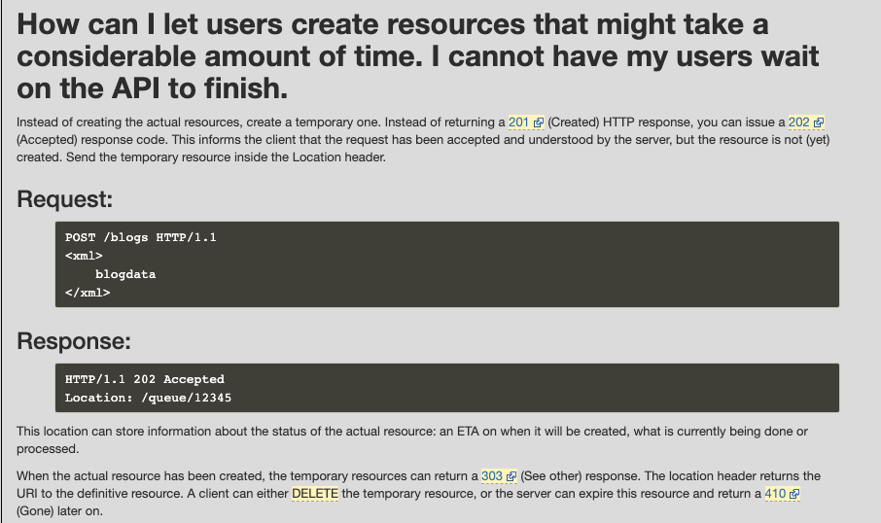
Asynchronous Requests – Pattern 1

Slide 21
Success Response Codes
202 means
Your request went asynch.
The HTTP header Link is where to poll for rsp.
Operation | HTTP Request | HTTP Response Codes Supported
READ | GET | 200 - OK with message body 204 - OK no message body 206 - OK with partial message body
CREATE | POST | 201 - Resource created (Operation Complete) 202 - Resource accepted (Operation Pending)
UPDATE | PUT | 202 - Accepted (Operation Pending) 204 - Success (Operation Complete)
DELETE | DELETE | 202 - Accepted (Operation Pending) 204 - Success (Operation Complete)
Examples of Link Headers in HTTP response:
Link: <http://api/jobs/j1>;rel=monitor;title="update profile"
Link: <http://api/reports/r1>;rel=summary;title=”access report”

Slide 22
Using a Cloud Service
22 | E6156 – Cloud Computing: Backend-as-a-Service

Slide 23
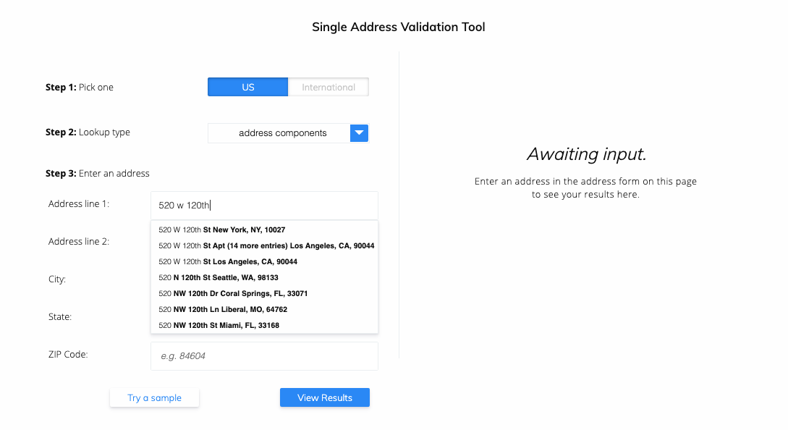
Address Verification (Demo)
People are really bad at entering addresses.
US, USA, United States, UK, England, ... ...
MA, Mass, Massachusetts, ... ...
NYC, New York, Manhattan, ... ...
W. 120th St, West 120 Street, ... ...
You should not have them enter an address, verify, reject, try again, reject, ... ... ➔ They will go to someone else.
You need to implement two functions:
In browser/UI completion suggestion.
In microservice verification before storing, in case no your UI.

Slide 24
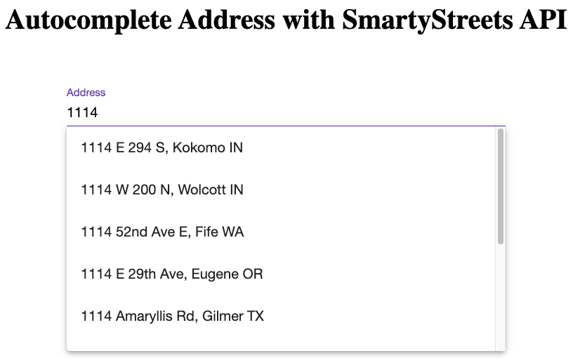
Address Verification (Demo)
https://github.com/shahinkar/Angular-SmartyStreets

Slide 25
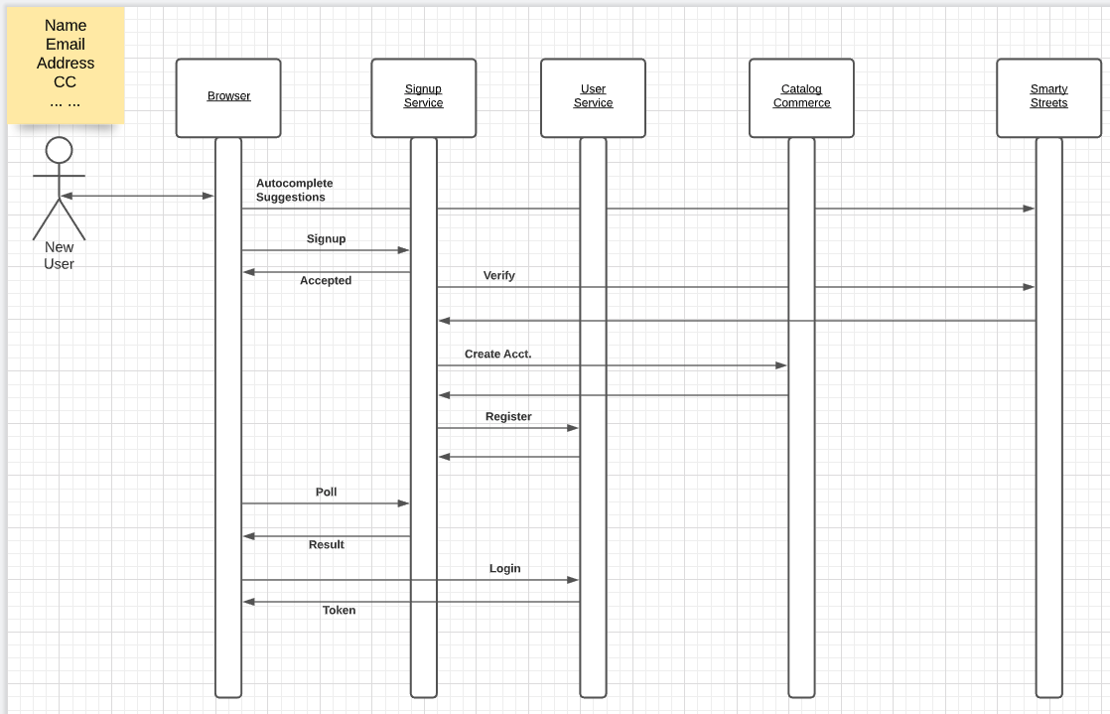
Address Verification Flow
You need to verify in the UI for usability.
You need to verify the address in case it the signup came from some other client/application.

Slide 26
Address Verification Flow
Demo Python Unit Test

Slide 27
Middleware
27 | E6156 – Cloud Computing: Backend-as-a-Service

Slide 28
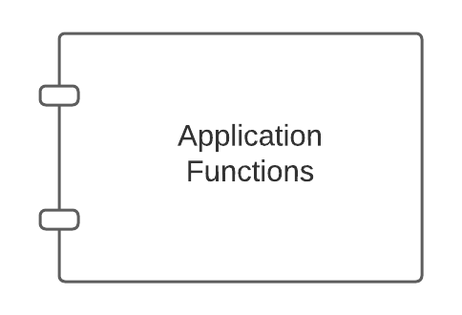
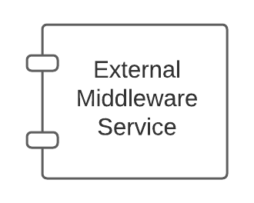
Middleware
There are app server specific approaches to injecting into the applications.

Slide 29
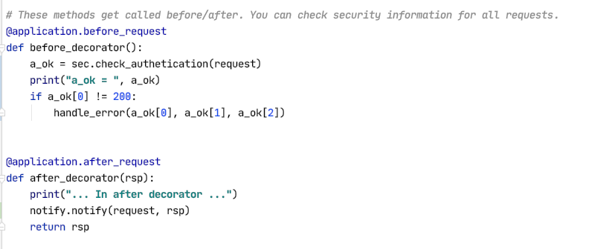
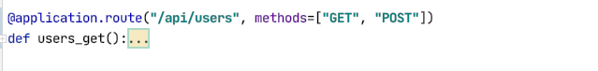
Middleware and Flask
White list of URLs
If not on white list:
Verify token
Verify authorization
List of filters of the form:
URL
HTTP Method
SNS topic to use
Send an event to SNS if matches filter
Show some demo code.

Slide 30
Big Picture Topology
30 | E6156 – Cloud Computing: Backend-as-a-Service

Slide 31
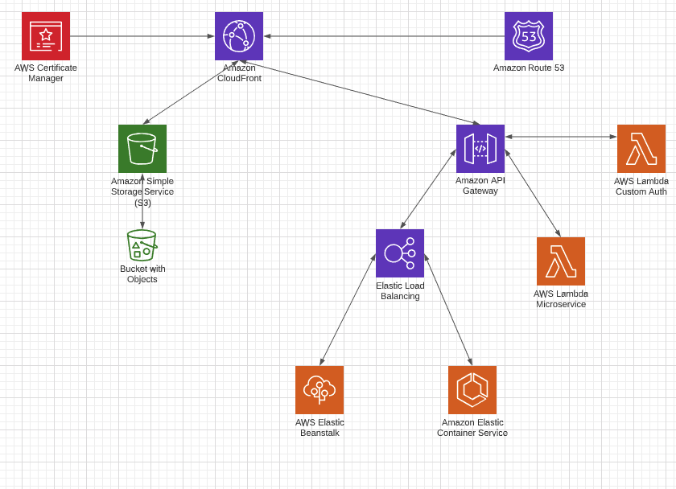
Big Picture Topology
Let’s start walking through the steps:
Domain/Route 53.
Certificate.
CloudFront.
Route 53.
CloudFront Again – S3.
API Gateway
Simple HTTP echo.
Lambda function.
CloudFront Again.
Load balancers.

